Slide 1
Gas Prices in Brazil
Analysis & Forecasting
ENERGY ANALYTICS FINAL PROJECT
Anna Christensen
Sonaxy Mohanty

Slide 2
Introduction
Energy data: complex, uncertain, many factors
Forecasting necessary for companies/entities to strategize production & logistics
Project focus: gasoline price data in Brazil
Brazil uses more ethanol (95 % flex fuel), increases uncertainty for gasoline (Stecker, 2013)
Global drop in oil price from 2014-2016 affects prices of petroleum products (Samuelson, 2014)
ARIMA models are common methods used to forecast energy data (Zhang and Zhao, 2022)
More advanced methods include machine learning models (Ceylan et al., 2022)

Slide 3
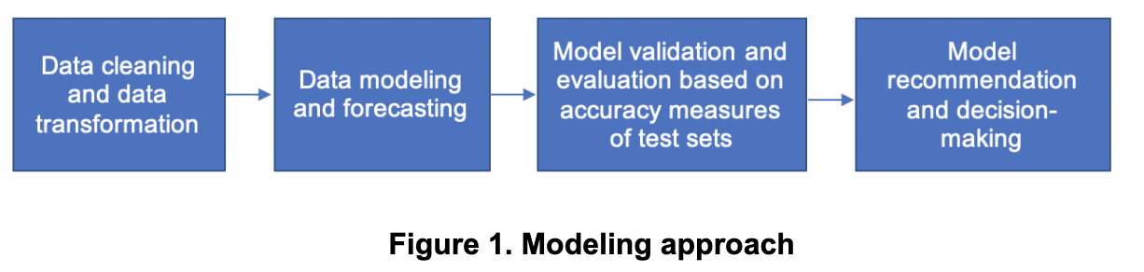
Project Description
Dataset
Weekly reports of prices for gasoline & other fuels in Brazil by state & region
Published by National Agency of Petroleum, Natural Gas, and Biofuels (ANP)
Observations from 2004 - May 2021, 120,823 observations
Focused on mean resale price and grouped by region and month
Approach:
Notes:
Mean resale price is not only per litre, but also per cubic meters and per 13 kilograms, that’s why we have to perform normalization

Slide 4
Data Overview & Preparation

Slide 5
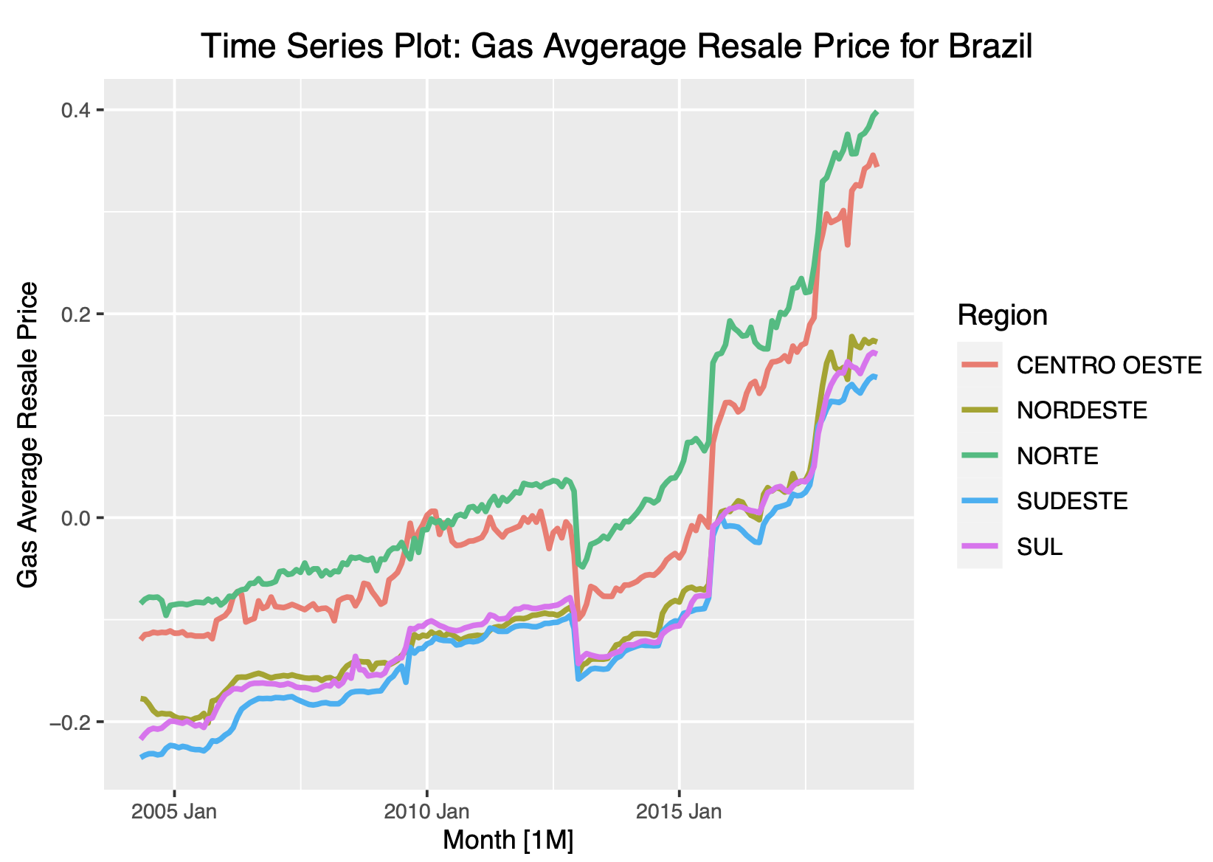
Autoplot
Upward trend in data
Unusual observations in 2014-2016 (oil price drop)
No strong seasonality
Trend is increasing (with exception of outlier period)

Slide 6
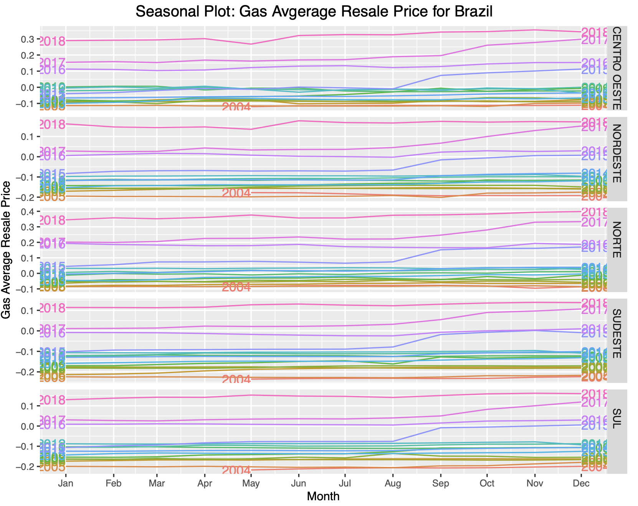
Seasonal Plot
Confirms no strong seasonality
Yearly trend of prices increasing at end of year, beginning around Aug.
Trend causes data series values to increase every year (with exception of outliers)

Slide 7
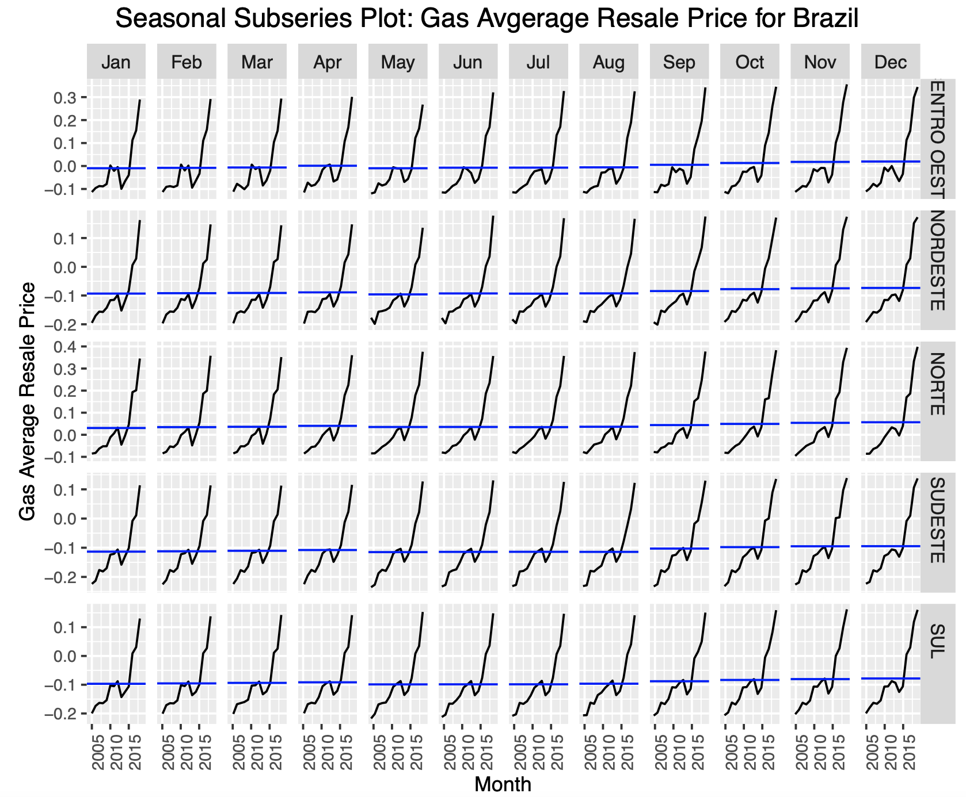
Subseries Plot
Again see increasing trend
Rate of trend increasing
Consistent outlier period from 2014-2016
Flat seasonal pattern

Slide 8
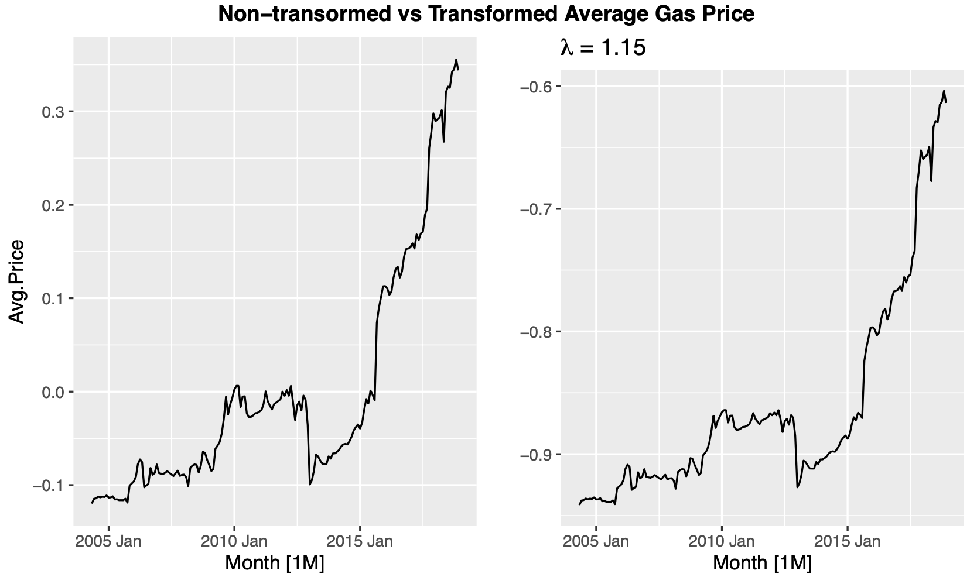
Missing Values & Transformation
A few gaps in the time series were imputed
Imputed mean of average resale price for that region
Data was centered and scaled when creating the tsibble object as prices are based on various different measurement units
A box-cox transformation was tested, but didn’t have a significant effect on the data
Notes:
price/liter, price/13 kilograms, or price/cubic meter
Basically z-score calculation to normalize data:
> Centering data means that the average of a variable is subtracted from the data.
> Scaling data means that the standard deviation of a variable is divided out of the data.

Slide 9
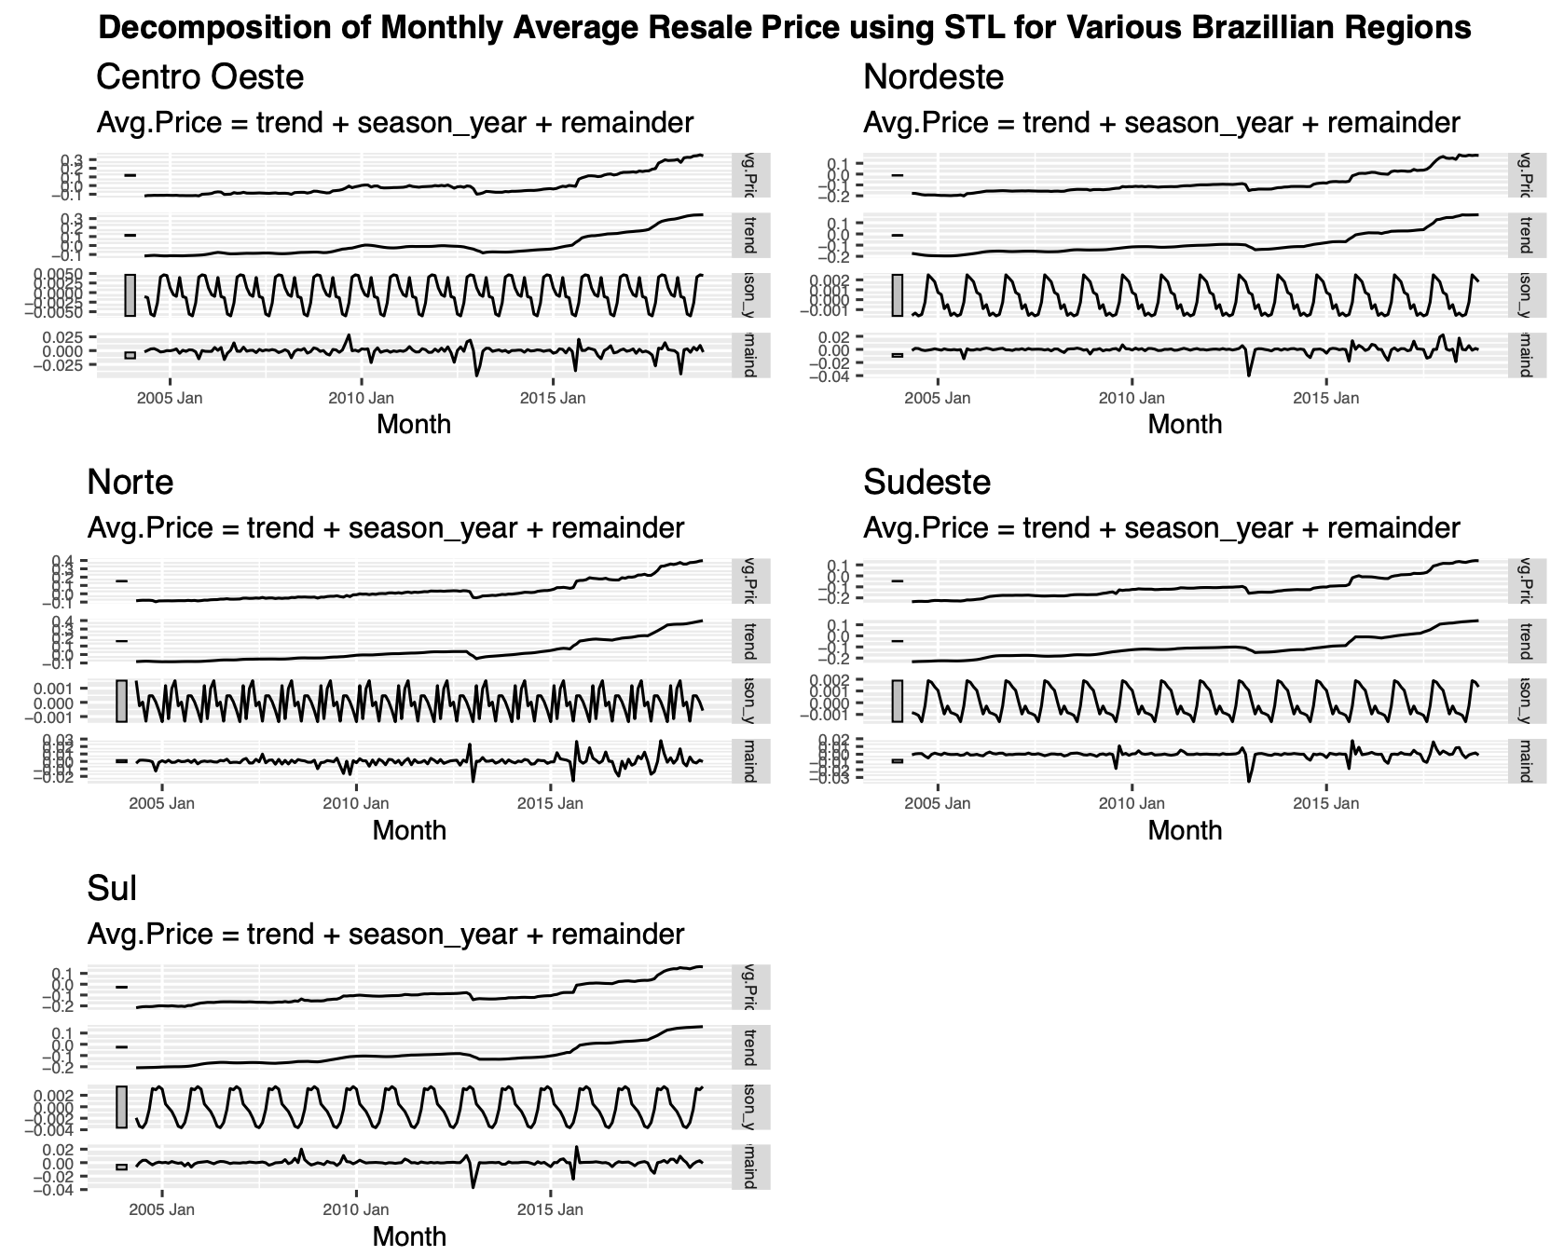
Decomposition
Trend is the largest component by far
There is a seasonal pattern but the scale is very small so it is insignificant
Some regions have more outliers/uncertainty than others
All regions share a common outlier of the 2014 price drop and 2016 price increase

Slide 10
Benchmark & Exponential Smoothing (ETS)
Models
Data divided into training & test set for model validation
Training: May 2004 - Dec 2018
Test: Jan - Dec 2019
Several benchmark methods fitted to data
Mean, Naive, Seasonal Naive, Drift
Default exponential smoothing (ETS) model fitted to data
Forecast generated for test set

Slide 11
ARIMA Modeling

Slide 12
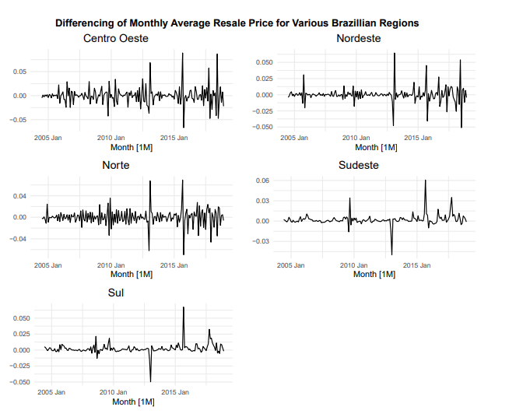
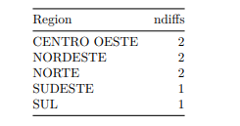
Stationarity and Differencing
Based on (KPSS) test, p-value = 0.01, rejecting the null hypothesis of data being stationary
No seasonal differencing required
Order differences implemented for different regions:

Slide 13
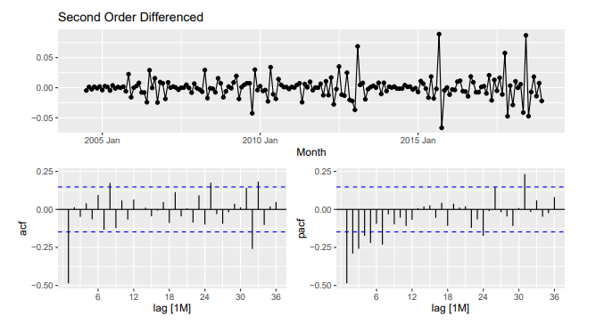
ACF and PACF plots
Focusing on one region - Centro Oeste - for ARIMA modelling
ACF plot shows a single spike at lag 1 and PACF exponentially decreases , i.e., MA(1) term
Best ARIMA model based on AICc value is ARIMA (0,2,1)

Slide 14
Model Evaluation

Slide 15
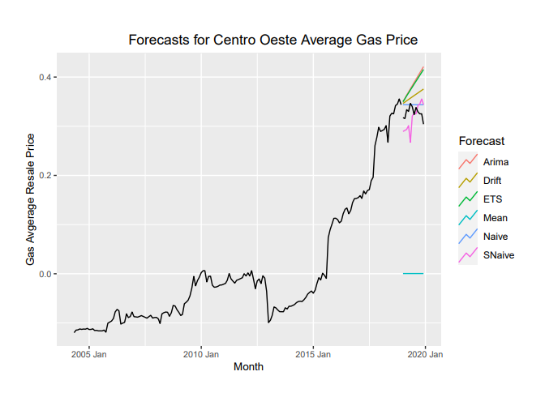
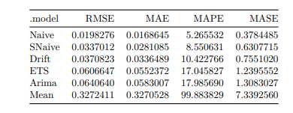
Forecast Plots
and
Accuracy Measures
Accuracy measures for the benchmark, ETS, & ARIMA model forecasts:

Slide 16
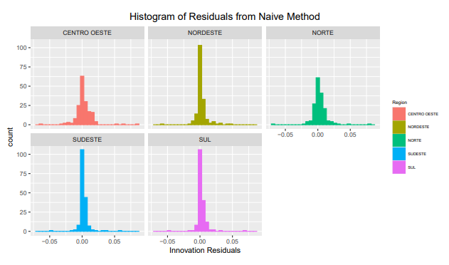
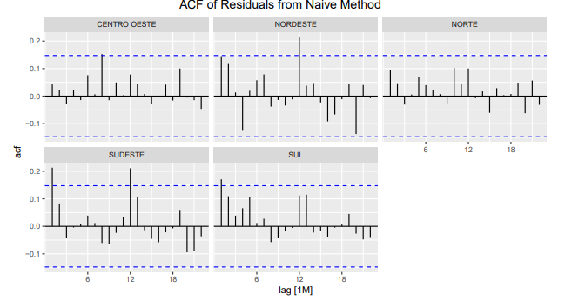
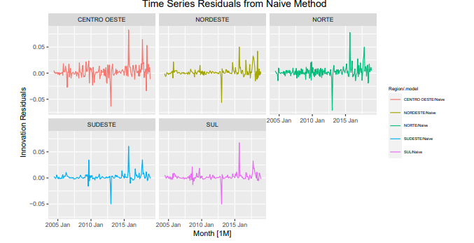
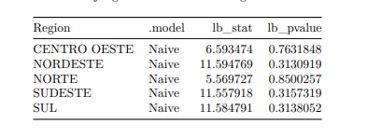
Residual Diagnostics
The histograms appear to be normally distributed and centered around zero
Variations in time series plots increase towards the end
The ACF plot shows no significant autocorrelation in residuals
Ljung-Box test confirms residuals resemble white noise:
Notes:
Charts are animated to come in and out so that they are big enough to see and we can fit them on the same slide.

Slide 17
Conclusion
Project Results:
Further research & analysis:
A simpler Naive model performed better than ARIMA and ETS models, with a RMSE value of 0.0198 and a MAPE value of 5.26%
A possible explanation is that the trend component plays a significant role in this time series data
Even removed any existing outliers and re-tested all the models, but Naive model again outperformed
Additional analysis: Neural Network model was developed to compare to Naive model
Forecasting for other regions
Forecasting hierarchical time series data - bottom up approach, beginning at product level and aggregating to region
Grey and Prophet models - gained popularity in forecasting energy data which are considered as non-stationary
Machine learning model - random forest has shown great success in forecasting energy data (Ceylan et al., 2022)
Notes:
Since the RMSE value was low, thought that the model might be overfitting due to presence of any outliers

Slide 18
References
Ceylan, Z., Akbulut, D., & Baytürk, E. (2022). Forecasting gasoline consumption using machine learning algorithms during COVID-19
pandemic. Energy Sources, Part A: Recovery, Utilization, and Environmental Effects, 1–19.
https://doi.org/10.1080/15567036.2021.2024919
Samuelson, R. J. (2014, December 3). Key facts about the Great Oil Crash of 2014. The Washington Post. Retrieved December 8, 2022,
From https://www.washingtonpost.com/opinions/robert-samuelson-key-facts-about-the-great-oil-crash-of-2014/2014/12/03/a1e
2fd94-7b0f-11e4-b821-503cc7efed9e_story.html
Stecker, T. (2013, October 17). How the oil embargo sparked energy independence - in Brazil. Scientific American. Retrieved December
8, 2022, from https://www.scientificamerican.com/article/how-the-oil-embargo-sparked-energy-independence-in-brazil/
Zhang, J., & Zhao, J. (2022). Trend- and periodicity-trait-driven gasoline demand forecasting. Energies,
15(10).https://doi.org/10.3390/en15103553

Slide 19
Thank you!
Questions?

